Slide 1

AI application for Image Restoration
Syed Sirajuddin, Ian Rebmann, Carlos Ortiz, Tadbhir Singh
University of San Diego
AAI-521: Applied Computer Vision for AI
Dr. Roozbeh Sadeghian
December 7, 2025

Slide 2

Table Of Contents
Computer Vision Tasks
Inpainting
Super Resolution
Colorization
Denoising
Web Application GUI Demo

Slide 3
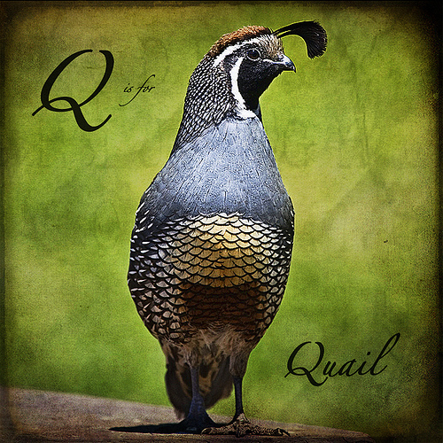
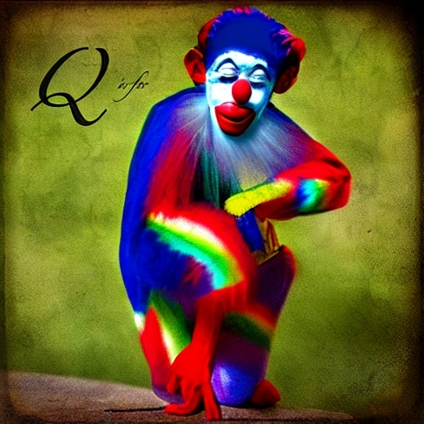
Inpainting - Diffusion-Based Image Inpainting with LoRA Fine-Tuning
Goal: restore missing/damaged regions seamlessly
Prioritized realistic, human-believable results
Secondary goal: reduce hallucinated text/labels/watermarks
Compared:
Base Stable Diffusion v1.5 Inpainting
LoRA-adapted variant

Slide 4
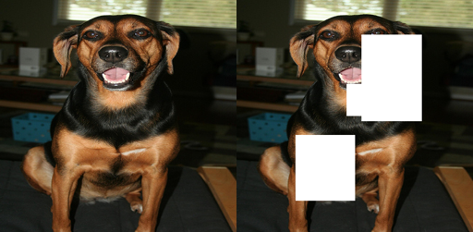
Inpainting - Controlled Damage + Masked Metrics
Dataset structure:
Original / damaged / mask aligned by filename
Resized to 512×512
Synthetic damage regimes:
Small masks: ~0.05–0.15 image size
Large masks: ~0.10–0.40 image size
Metrics:
Masked PSNR & Masked SSIM (primary)
Global PSNR/SSIM (secondary)

Slide 5
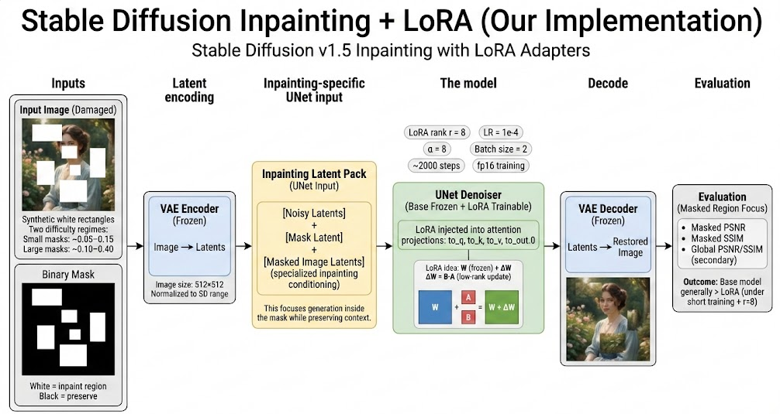
Inpainting - Architecture & Training Strategy
Latent diffusion pipeline
VAE encodes image → latents
Text encoder → prompt embeddings
UNet denoises across schedule
Inpainting UNet input is 9-channel
4 noisy latents + 1 mask + 4 masked-image latents
LoRA applied to attention
target modules: to_q, to_k, to_v, to_out.0
VAE + text encoder + base UNet weights frozen

Slide 6
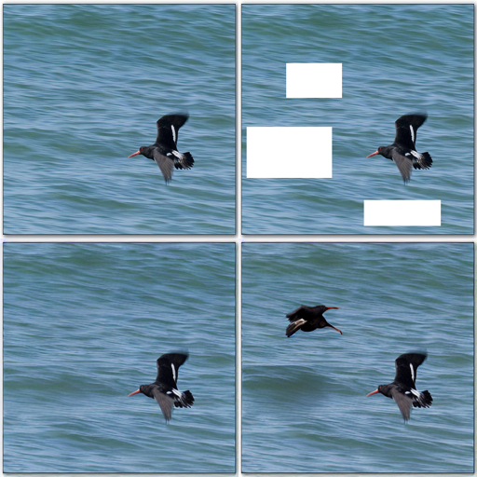
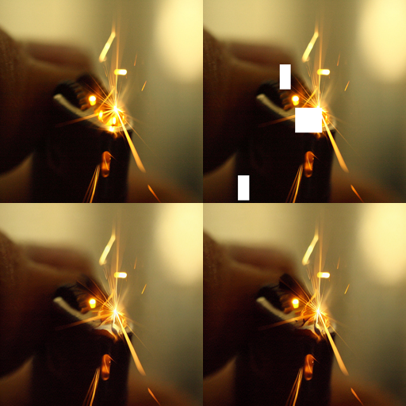
Inpainting - Evaluation and Future Improvements
Small masks
LoRA win-rate: PSNR 32%, SSIM 25%
Base mean masked PSNR 17.998 vs LoRA 17.541
Large masks
LoRA win-rate: PSNR 26%, SSIM 25%
Base mean masked PSNR 13.963 vs LoRA 12.919
Large Masks
Small Masks
Interpretation:
Base model already strong
LoRA likely underpowered for large-region priors
Metrics may understate perceptual quality
Future improvements:
formal train/val/test split
mix small + large + irregular masks
test higher LoRA rank (16–32) + longer training
stratify results by mask area %
Top-left: original | Top-right: damaged | Bottom-left: base | Bottom-right: LoRA

Slide 7

Image Super-Resolution – Model & architecture
Enhance Low Resolution Images
Swin2SR with 4x Upscaling Factor
Output is 4x larger in height & width
Pixel count is 16x more than input
(256x256)→(1024x1024)
(64x64)→(256x256)
Transformer Based Architecture
Shallow Feature Extraction
Initial convolution captures low- frequency info via skip connection
Deep Feature Extraction
Stack of SwinV2 transformer blocks with windowed self attention
Captures structure (local & global)
HQ Image Reconstruction
Combines features
Up sampling produces 4x output
Model specifics
Architecture: SwinV2 Transformer–based SR
Checkpoint: caidas/swin2SR-realworld-sr-x4-64-bsrgan-psnr
Parameters: ~12M, optimized for real‑world degradations

Slide 8
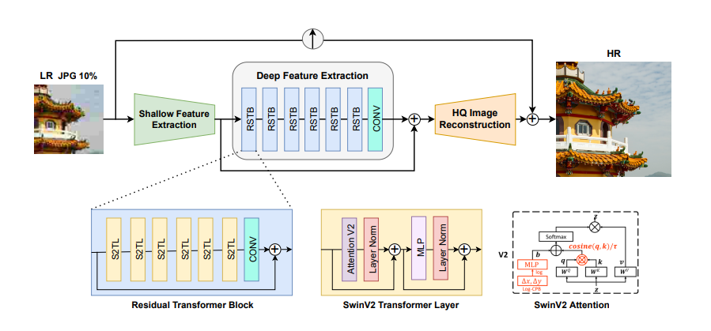
Image Super-Resolution – architecture diagram
Conde, M. V., Choi, U. J., Burchi, M., & Timofte, R. (2022). Swin2SR: SwinV2 transformer for compressed image super-resolution and restoration (arXiv:2209.11345). arXiv. https://doi.org/10.48550/arXiv.2209.11345

Slide 9
Image Super-Resolution – Data & training
Dataset: DIV2K
High-Quality Training Data
800 training images
High-resolution reference images
100 validation images
Independent evaluation set
Random patch extraction
64×64 low-resolution patches
256×256 high-resolution ground truth
Creates large effective dataset from limited base images
Fine-Tuning Methodology
Pretrained Model Adaptation
Starting checkpoint
Swin2SR realworld ×4 (caidas/swin2SR-realworld-sr-x4-64-bsrgan-psnr)
12M parameters pretrained on diverse degradations
Training configuration
Loss function: L1 reconstruction loss
Optimizer: Adam with small learning rate
GPU: NVIDIA A100 (80GB)
Total training steps: 1,300

Slide 10
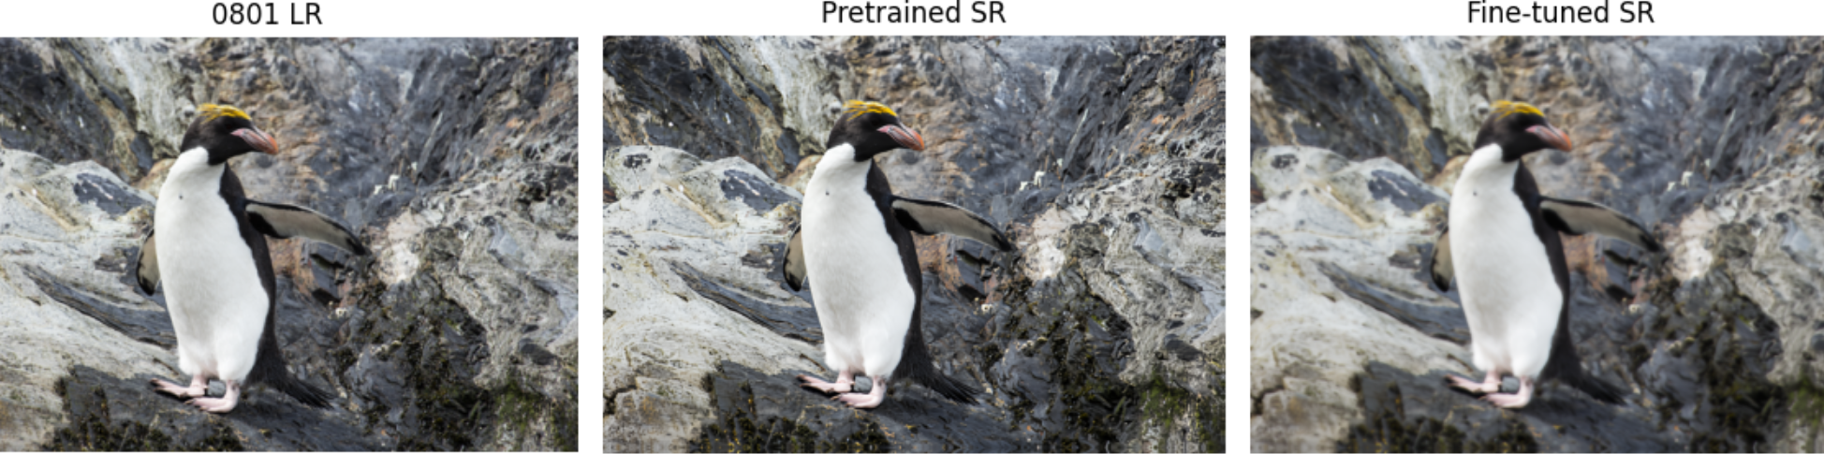
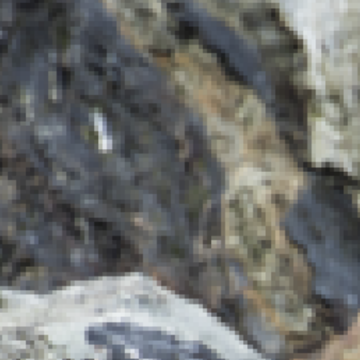
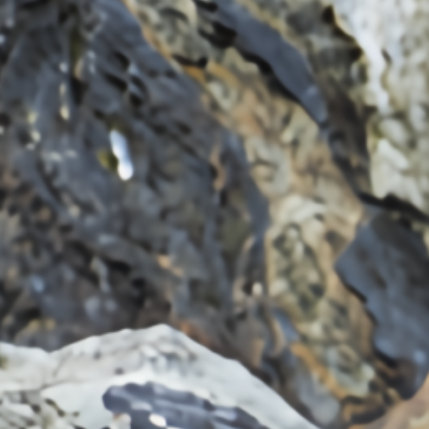
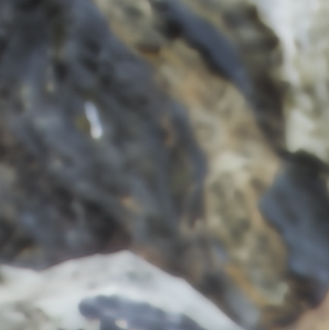
Image Super-Resolution – results

Slide 11
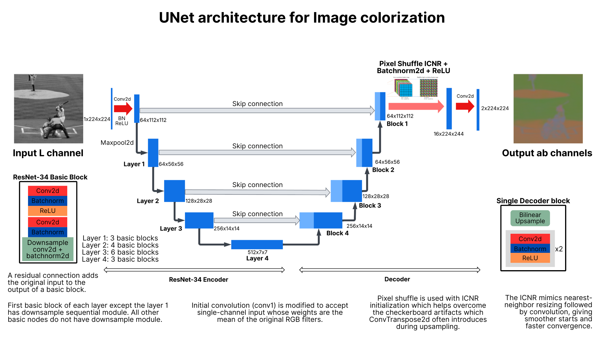
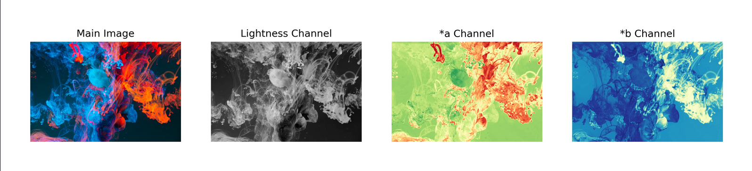
Image Colorization – architecture
https://huggingface.co/ayushshah/imagecolorization
https://github.com/ayushpatidar18/Image-Colorization

Slide 12
Image Colorization - dATASET & preprocessing
Curated COCO 2017 dataset (no grayscale, b/w, filtered images).
Resizing (224x224)
Google Collab
T4 GPUs, 20h+
Inference preprocessing
Module resizing
BGR/RGB to Grayscaled Lab (L) -> 1D tensor [0,1]
Inference preprocessing
Inference postprocessing
Denormalizing *a and *b channels
LAB2RGB conversion (or BGR)

Slide 13
Image Colorization - dATASET & preprocessing
Curated COCO 2017 dataset (no grayscale, b/w, filtered images).
Resizing (224x224)
Google Collab
T4 GPUs, 20h+
Inference preprocessing
Module resizing
BGR/RGB to Grayscaled Lab (L) -> 1D tensor [0,1]
Inference preprocessing
Inference postprocessing
Denormalizing *a and *b channels
LAB2RGB conversion (or BGR)

Slide 14
Denoising – model & architecture

Slide 15
Denoising – data & Methodology

Slide 16
Web App GUI (Streamlit Agent Interface)
Purpose: Provide a user-facing demonstration that translates our restoration models into a practical workflow beyond offline notebooks.
Supported Tasks: Denoising, Super-Resolution, Colorization, and Inpainting with task-specific controls shown only when relevant to reduce UI clutter and user error.
Inpainting Capabilities: Mask drawing or mask upload; adjustable brush size/color/opacity; faded-image background for mask legibility; invert-mask option; binary mask preview enforcing the rule: white = fill, black = keep.
Advanced Controls: Prompt and negative prompt, strength (where applicable), guidance scale, inference steps, and seed for controlled base vs LoRA comparisons.
Usability Features: Standard-sized input previews, clear separation of previews vs full-resolution displays, and contextual help messages when masks are not required.
Deployment Value: Demonstrates applied system validation and real-world readiness by linking model outputs to an interactive restoration interface aligned with project rubric expectations.

